Slide 1
Ames Housing
Aidan Dominguez

Slide 2

Problem Statement
As a real estate agent, for what reasons would I recommend a 1-story over 2-story house to first-time home buyers?

Slide 3
Feature Selection
Correlations
Typical / Practical Metrics
PolynomialFeatures
LASSO CV

Slide 4
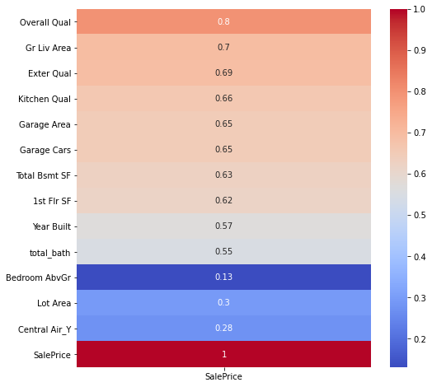

Slide 5
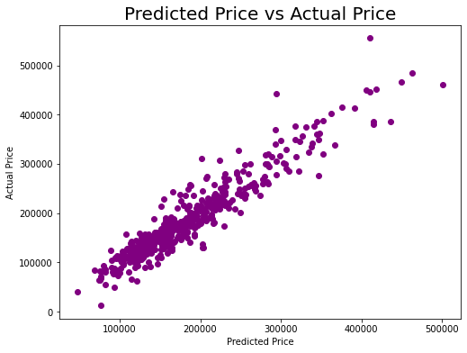
Predictions
Linear

Slide 6
Summary: 1-story
Price - $170,889
Overall Qual - Average / Above Average
Lot Area - 10,223 sqft
Total Basement sqft - 1121
Total baths - 1.6
Garage Cars - 1.69
Garage Area - 460 sqft
External Quality - Average / Typical

Slide 7
Summary: 2-story
Price - $206,235
Overall Qual - Above Average / Good
Basement sqft - 915
Total Baths - 2.7
Garage Cars - 1.97
Garage Area - 508 sqft
Exterior Quality - Average / Good

Slide 8
Differences
1-story
Lot - 3,000 sqft larger
Price - $35,000 cheaper
Larger basement - 200 more sqft
2-story
Newer (1 year)
Overall Quality - 1 grade better
More baths - 1

Slide 9
Extra Information
Average lot size has decreased by 38% between 2009 and 2014
Building more on less space
Higher demands for walkable neighborhoods and urban amenities
https://www.desmoinesregister.com/story/money/business/development/2015/06/20/bigger-homes-smaller-lots-prairie-trail/29010087/

Slide 10
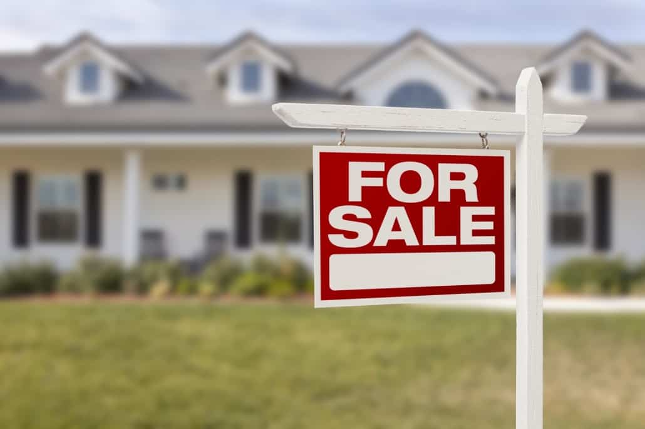
Recommend: 1-Story Home
Pros
More affordable
Substantially bigger lot
Larger Basement
Comparable Garage
Cons
1 less bathroom
Smaller Garage

